Slide 1
Summary of Last Year and Development Plan for the Future

Slide 2
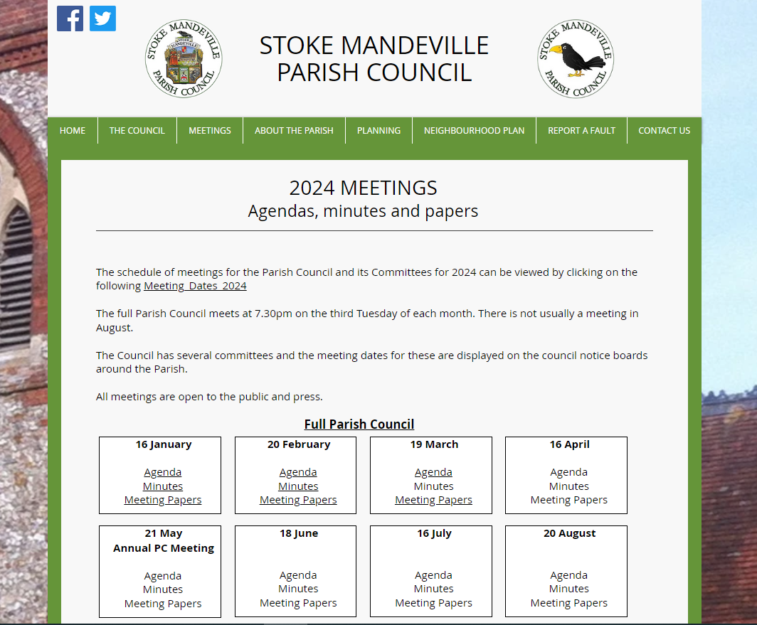
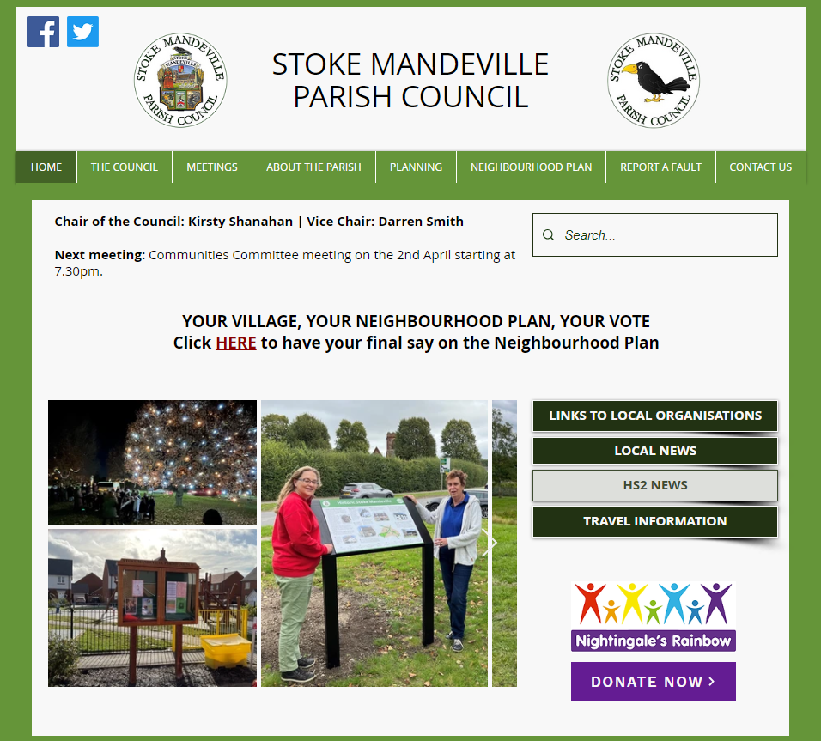
APRIL
New website went live

Slide 3
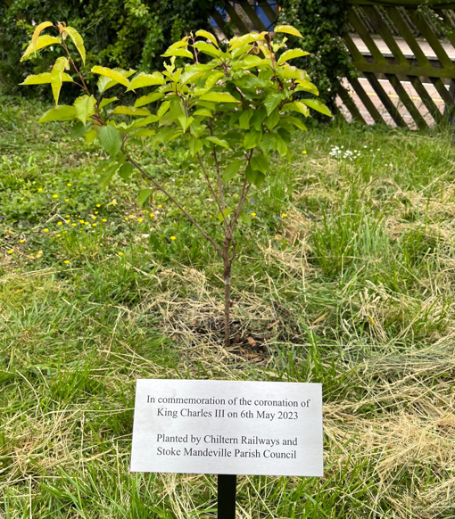
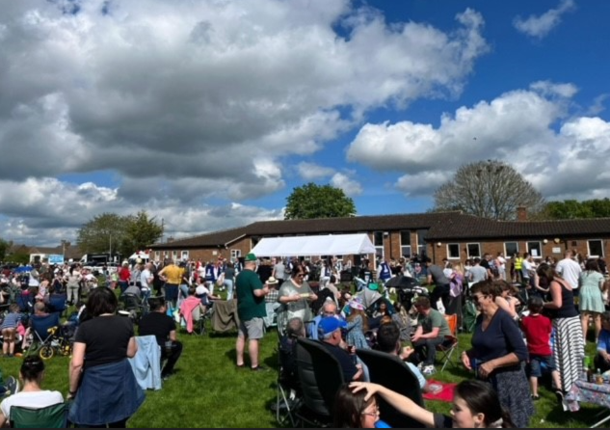
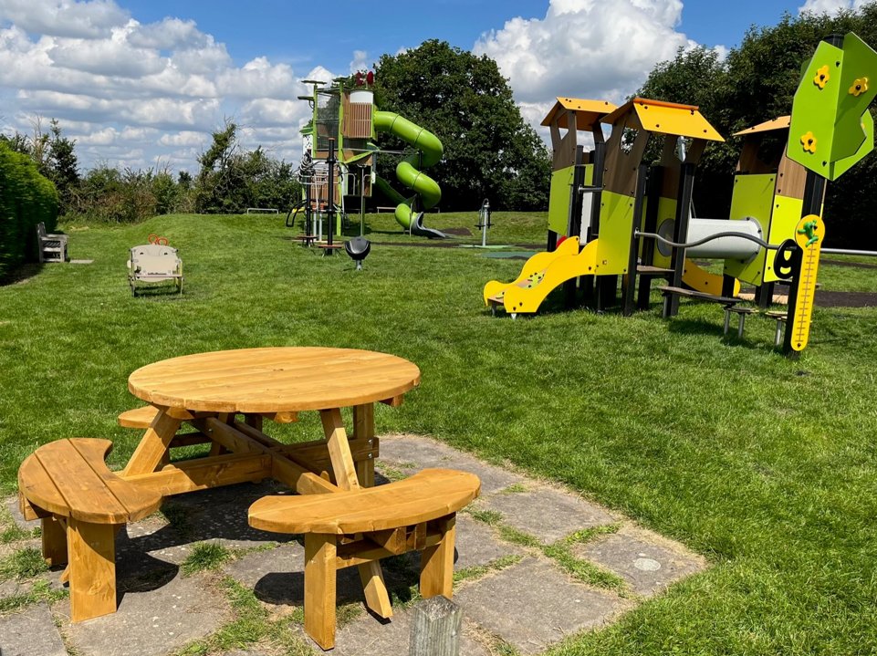
MAY
Parish Council became sole Trustees of SMVCA, transferring running of Eskdale Road Community Centre to the PC
Installed a plaque commemorating King’s Coronation by a plum tree at the railway station
Organised King’s Coronation community event at Eskdale Road
New playground was officially opened

Slide 4
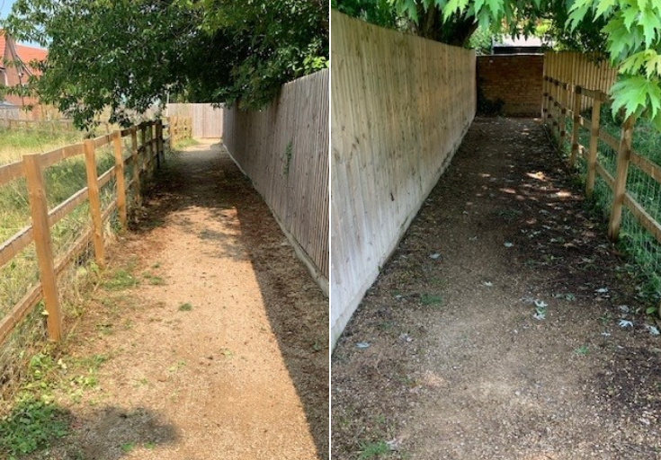
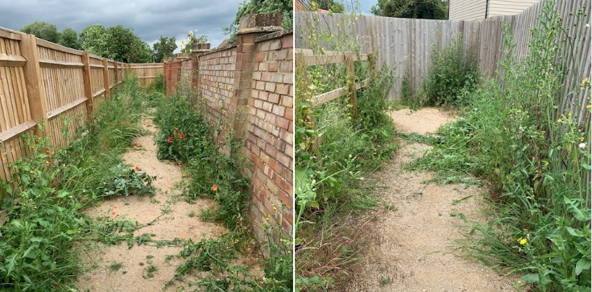
JUNE
Working Group formed to solidify the Parish Council’s proposals for the ex-BCSSC site
New report on asbestos at the new burial ground was completed allowing plans to proceed
Path from the church to The Hawthorns estate was cleared
Agreement to part-fund a project to improve the Green at the railway station

Slide 5
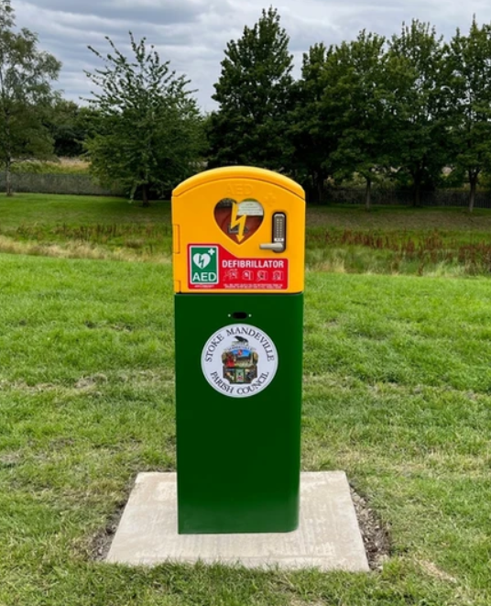
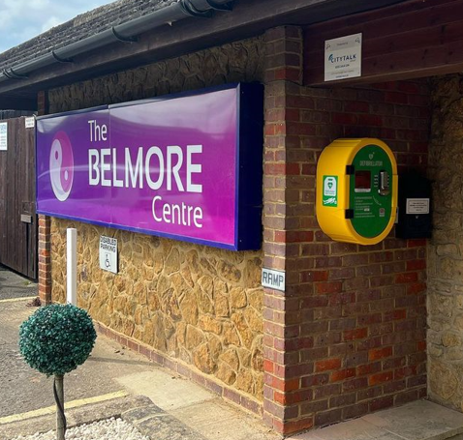
JULY
New defibrillator installed on Stoke Grange to add to the one installed at The Belmore in May

Slide 6
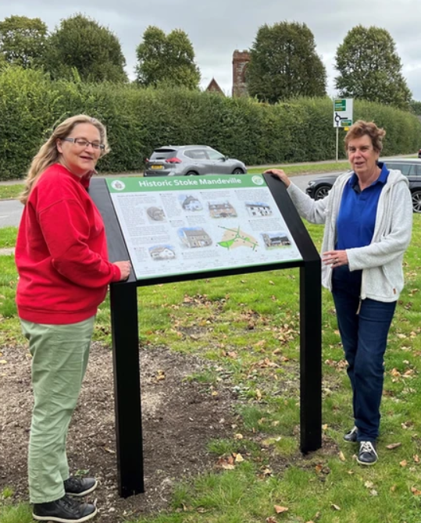
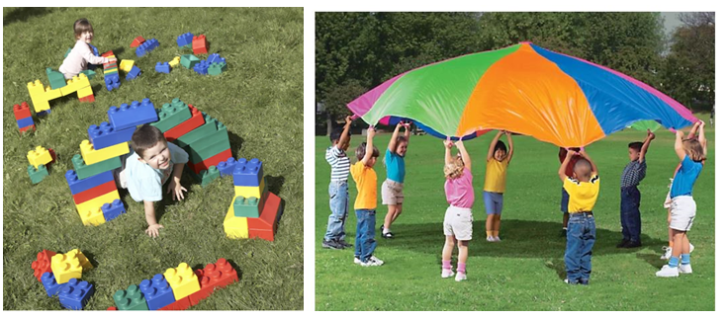
AUGUST
Play Ranger sessions organised for local children at Hawkslade and Eskdale Road
Heritage information board installed on the Village Green – joint project with The Village Society

Slide 7
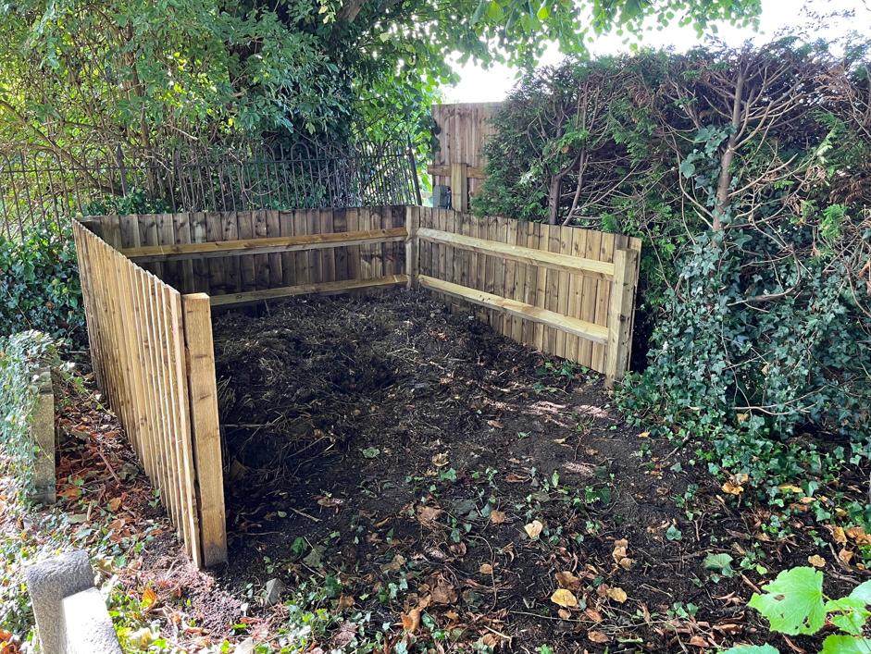
SEPTEMBER
Carol Jenkins co-opted onto the Parish Council
Formal consultation on parking scheme for Dorchester Close and nearby roads given the go-ahead
Consultant engaged to report on cracking to path on the playing field
Quarterly e-newsletter first issue produced with 125 residents currently signed up
Agreement to not increase the Parish Precept for 2024/25
Compost bin constructed at the burial ground

Slide 8
OCTOBER
Traffic Working Group formed in response to residents’ concerns about speed on Wendover Road
Received Certificate of Merit in Best Kept Village Competition

Slide 9
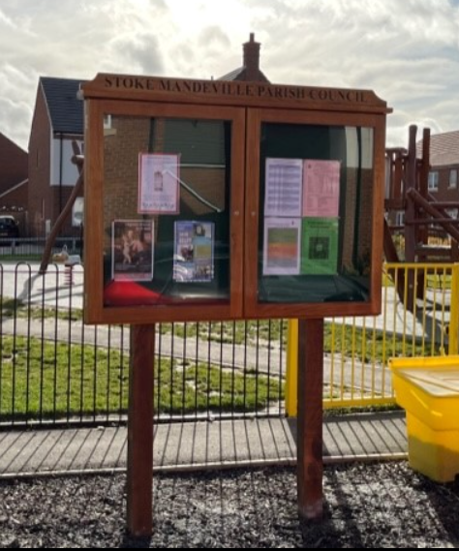
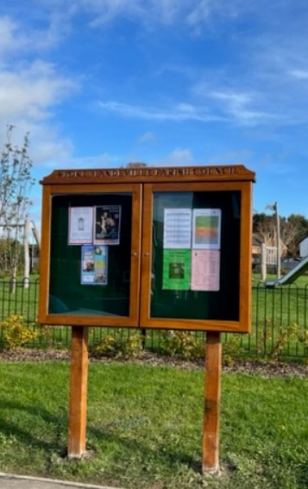
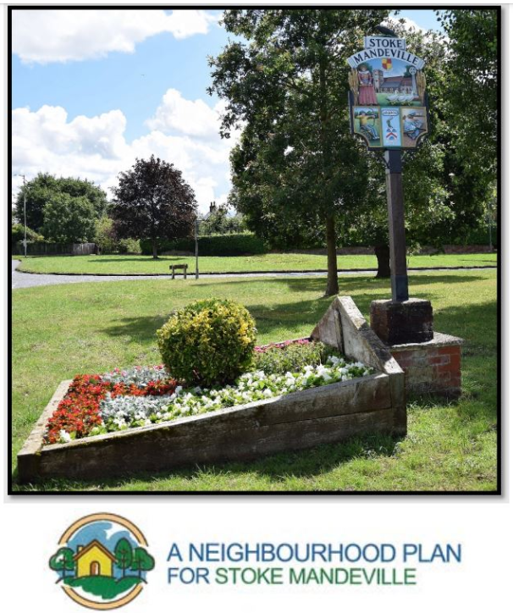
NOVEMBER
New Parish Noticeboards installed on Roylands and Harborne Manor estates
Stoke Mandeville Neighbourhood Plan submitted to Buckinghamshire Council
Jamie Hudson co-opted to the Parish Council

Slide 10
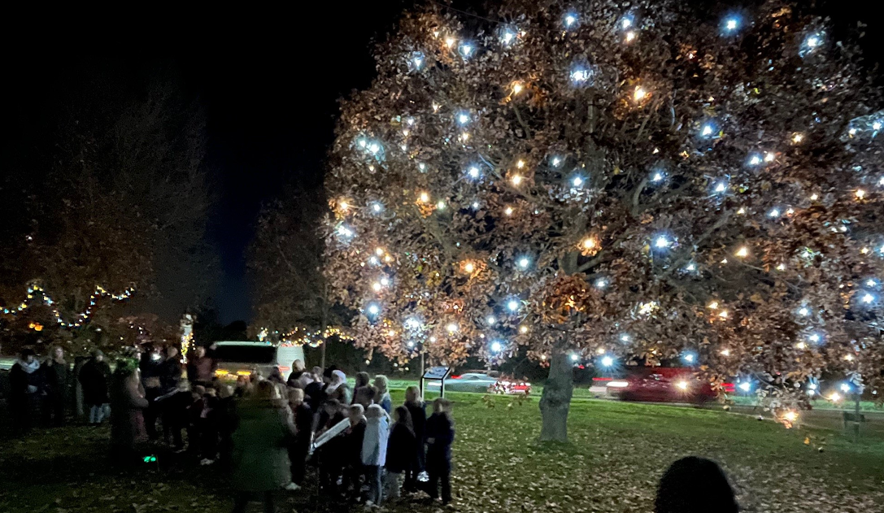
DECEMBER
D-Day 80th anniversary planning commenced
Party in the Park Working Group formed
Christmas lights switch-on event organised with the School and The Village Society input

Slide 11
JANUARY
Booked 4 play sessions for the summer holidays, double last year and more for older children
Clerks started attending a monthly coffee & chat session with residents at The Ark
Agreed to install a ‘post and rope’ barrier around the Brudenell Drive Green
Agreed to install 2 benches in Winterton Drive

Slide 12
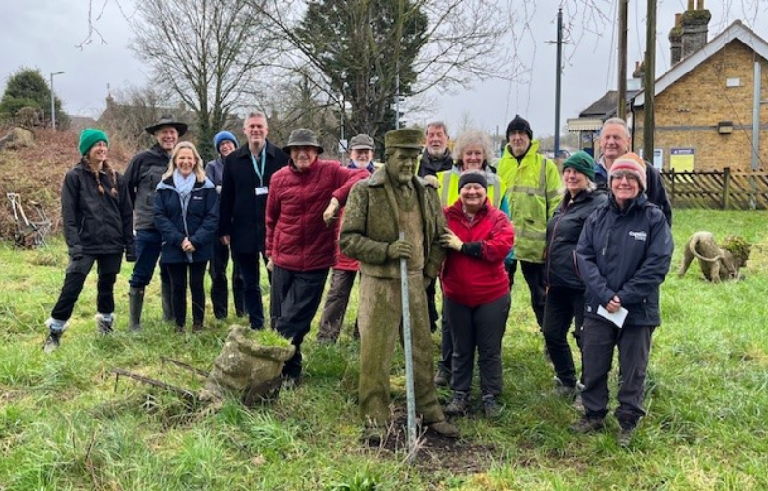
FEBRUARY
Met with Booker Park School about the former BCSSC site
Submitted bid to buy former BCSSC site to Buckinghamshire Council
Jon Theobald co-opted onto the Parish Council
Chiltern Society carried out planting and clearance at the station Green

Slide 13
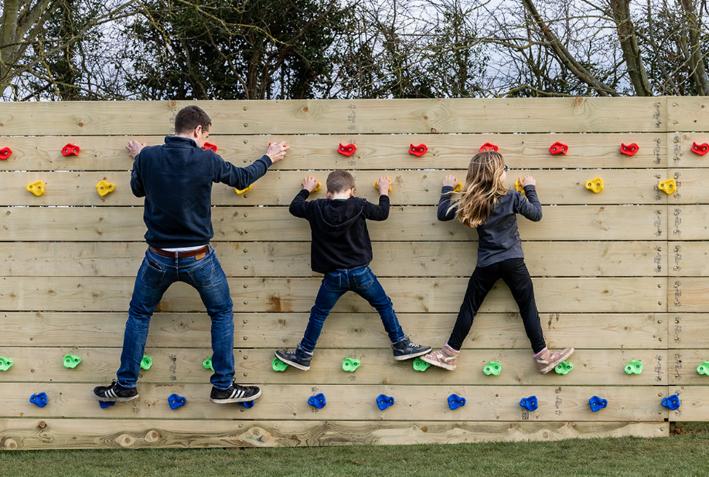
MARCH
Councillors awayday to initiate the Parish Council Development Plan
Selected preferred supplier for solar panels for the Community Centre after tender process
Monkey Challenge wall ordered for installation on playing field in May

Slide 14
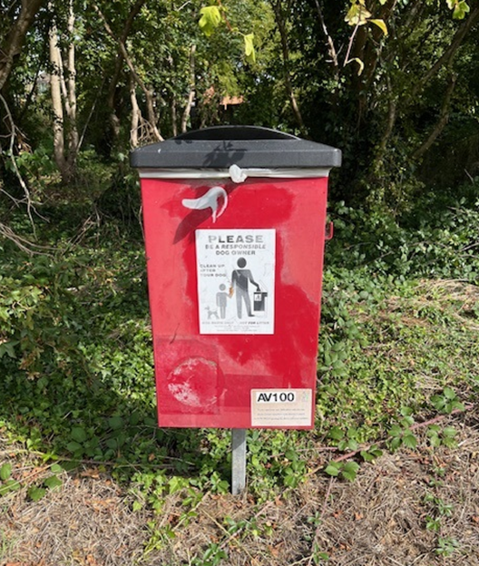
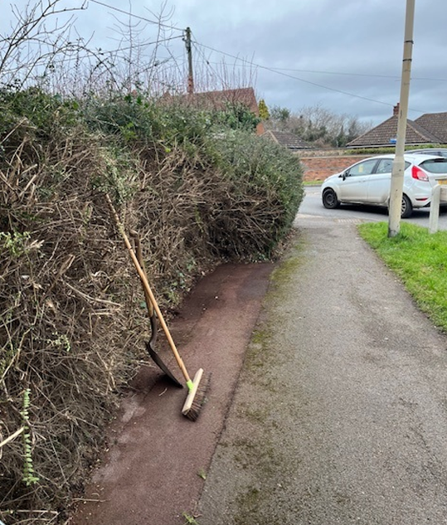
THROUGHOUT THE YEAR
The Clerk and Assistant Clerk underpin all our activities with their enthusiasm and effort, supporting and advising Councillors to move projects forward, and showing proactivity and initiative to get things done for residents:
Regular meetings with HS2
Pruning overgrown hedges
Arranging for the repair of streetlights
Administering allotments – 3 changes in tenancy and 22 on the waiting list
New dog waste bins installed
Meetings on design and implementation plan for new burial ground
THANK YOU, TONY AND PETER!

Slide 15
Parish Development Plan
Parish Council objectives and how to achieve them

Slide 16
Our Values:
- Approachable - Transparent - Inclusive - Supportive
Work towards becoming sustainable, low carbon and environmentally friendly
Develop accessible, affordable transport links to connect different Wards in the Parish
Create a sense of belonging to a cohesive community called Stoke Mandeville
Take a proactive approach to leading and building a community of all ages
Look at ways the PC can improve the physical and mental health and wellbeing of residents of all ages
Approach:
In participation with other organisations and professionals
Objectives

Slide 17
What initiatives could the Parish Council lead or support to develop accessible, affordable transport links to connect different Wards in the Parish?

Slide 18
What initiatives could the Parish Council lead or support to work towards becoming sustainable, low carbon and environmentally friendly?

Slide 19
What initiatives could the Parish Council lead or support to create a sense of belonging to a cohesive community called Stoke Mandeville?

Slide 20
What initiatives could the Parish Council lead or support as part of a proactive approach to leading and building a community of all ages?

Slide 21
What initiatives could the Parish Council lead or support to improve the health and wellbeing of residents of all ages?

